Slide 1
Network Basic

Slide 2
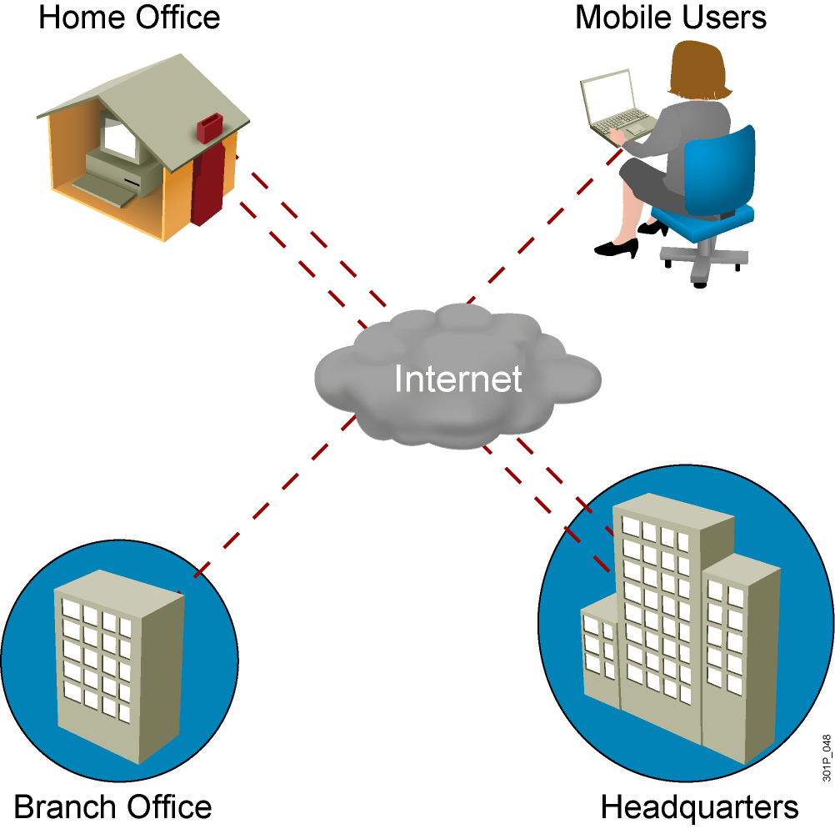
What Is a Network?

Slide 3
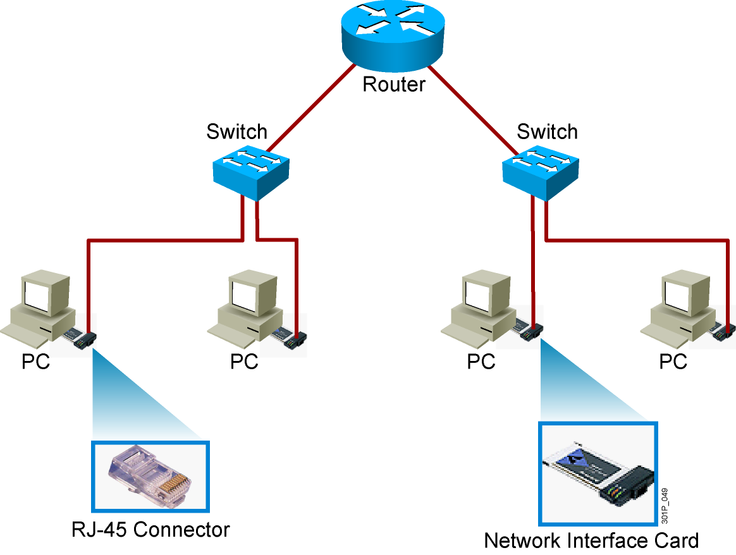
Common Physical Components of a Network

Slide 4
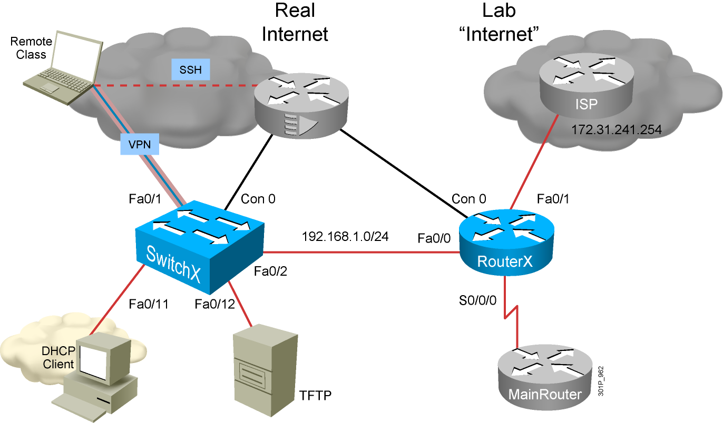
Interpreting a Network Diagram

Slide 5
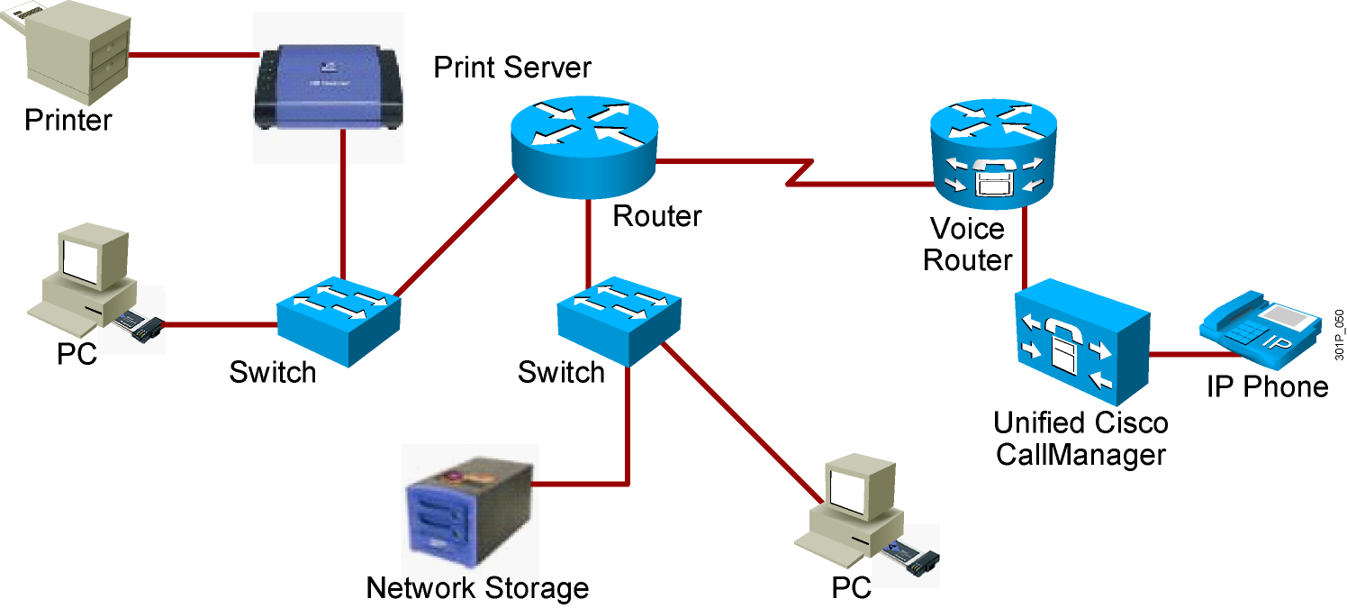
Resource-Sharing Functions and Benefits
Data and applications
Resources
Network storage
Backup devices

Slide 6
Characteristics of a Network
Speed
Cost
Security
Availability
Scalability
Reliability
Topology

Slide 7
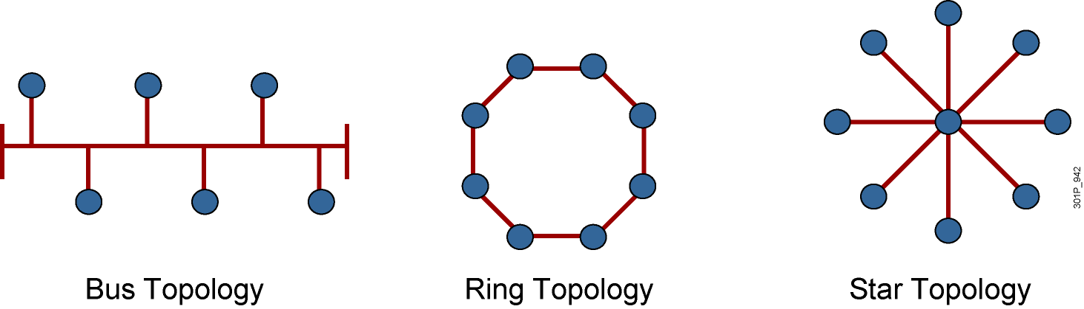
Physical Topology Categories
Notes:
Lesson Aim
<Enter lesson aim here.>

Slide 8
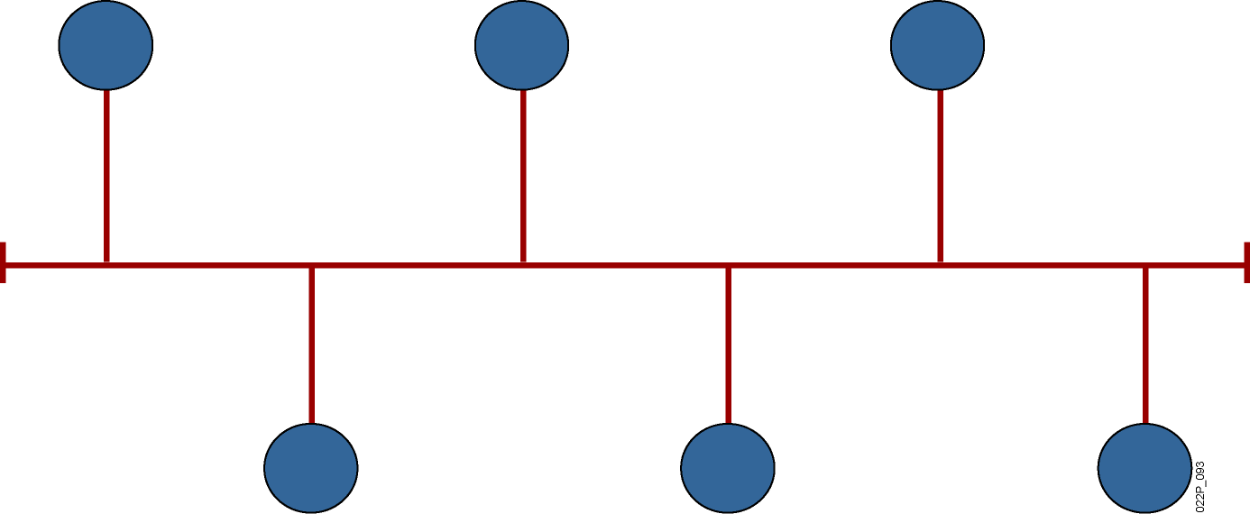
Bus Topology
All devices receive the signal.
Notes:
Lesson Aim
<Enter lesson aim here.>

Slide 9
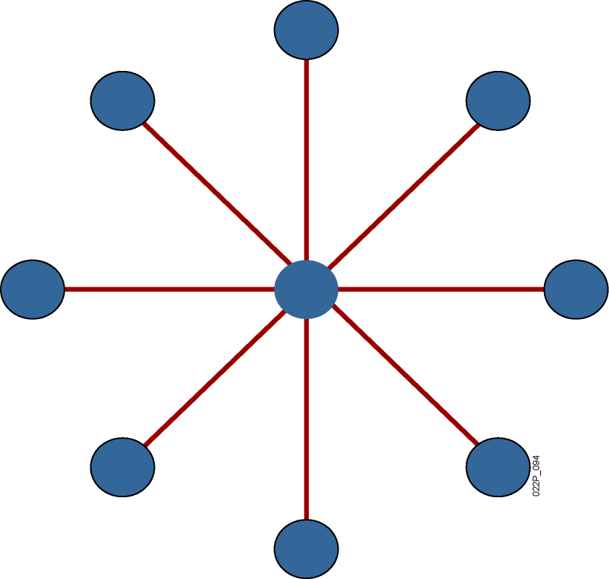
Star Topology
Transmission through a central point.
Single point of failure.

Slide 10
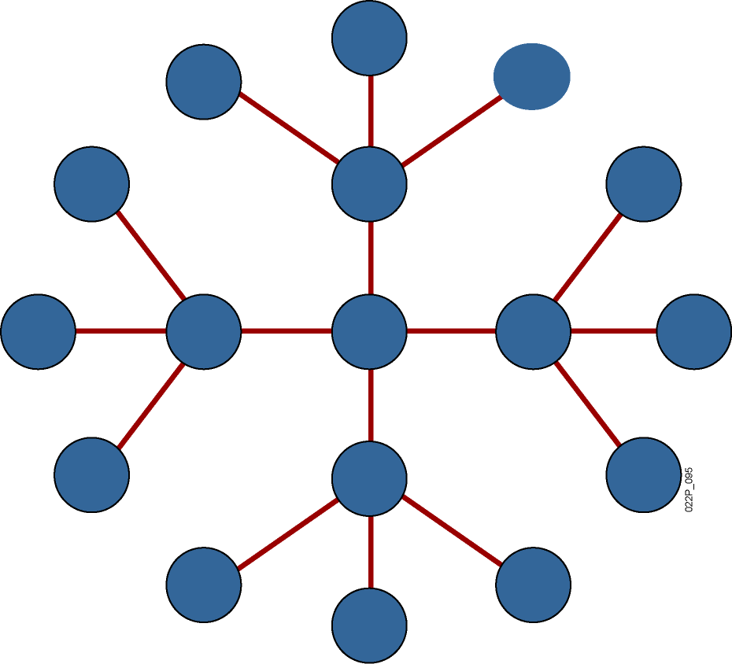
Extended-Star Topology
More resilient than star topology.
Notes:
Lesson Aim
<Enter lesson aim here.>

Slide 11
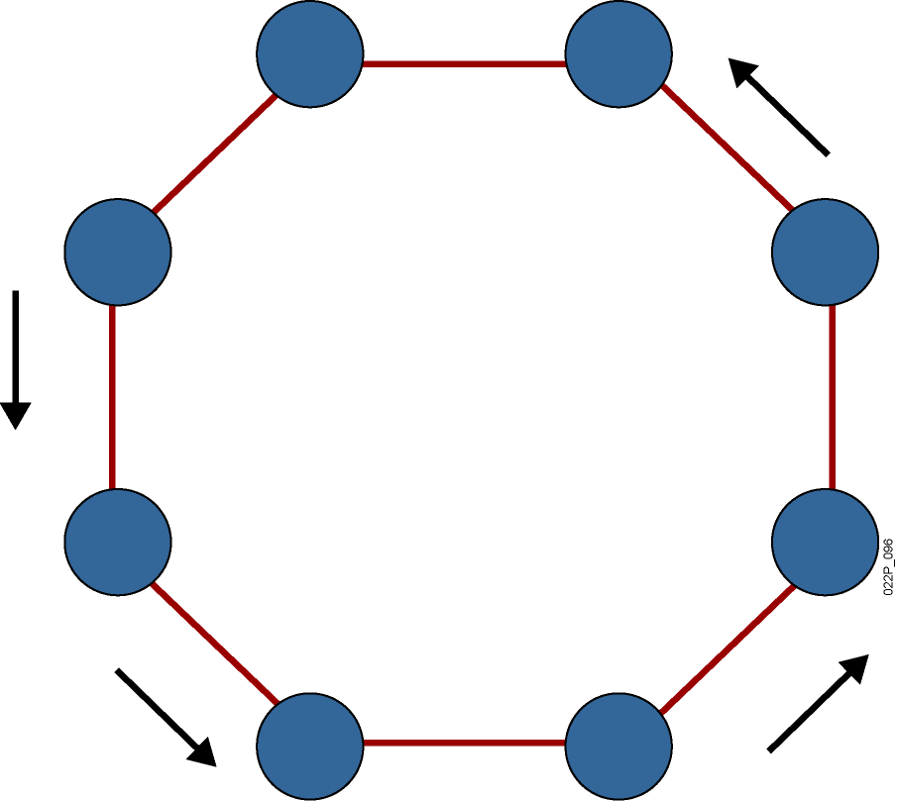
Ring Topology
Signals travel around ring.
Single point of failure.
Notes:
Lesson Aim
<Enter lesson aim here.>

Slide 12
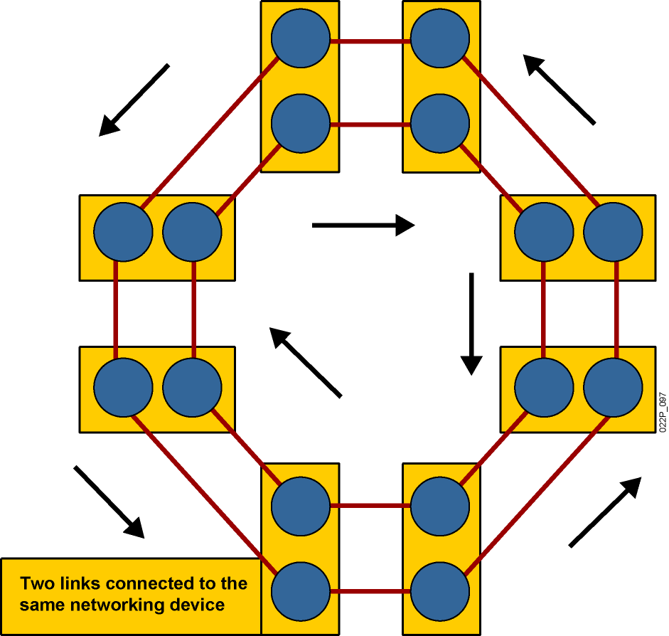
Dual-Ring Topology
Signals travel in opposite directions.
More resilient than single ring.
Notes:
Lesson Aim
<Enter lesson aim here.>

Slide 13
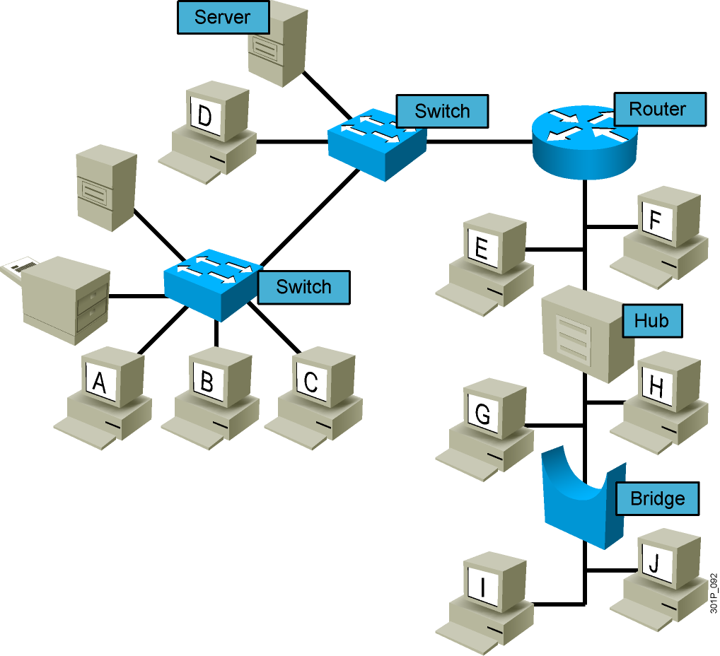
Logical Topologies
Notes:
Lesson Aim
<Enter lesson aim here.>

Slide 14
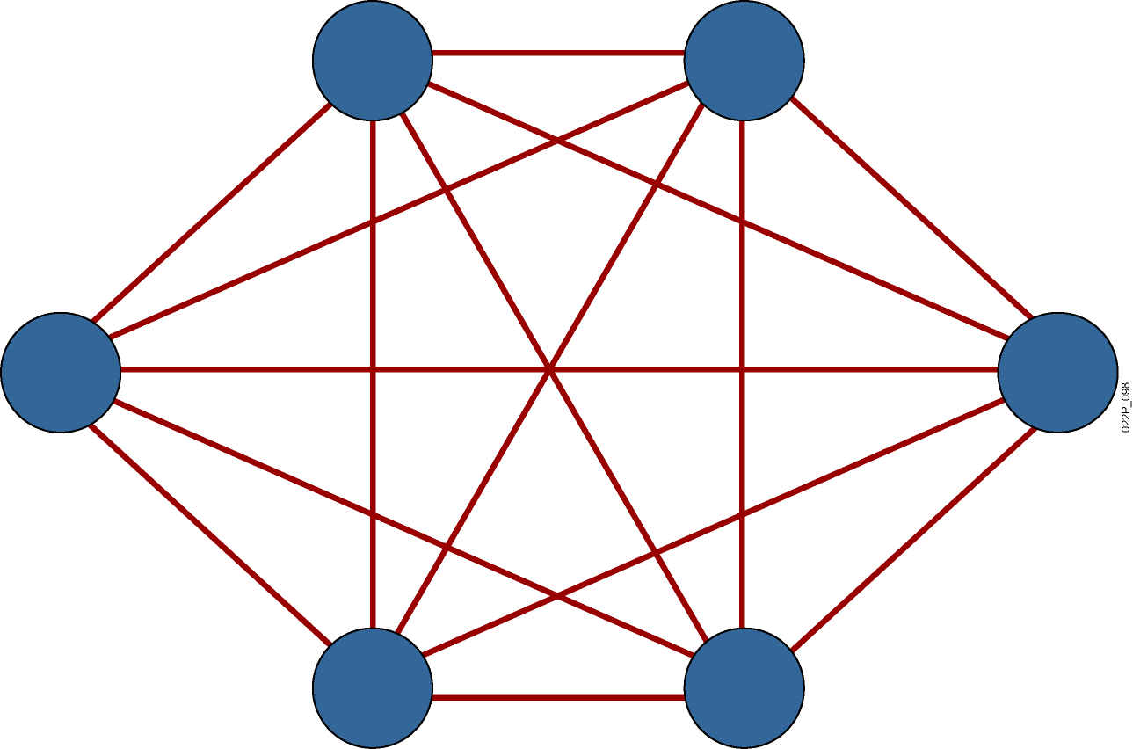
Full-Mesh Topology
Highly fault-tolerant
Expensive to implement
Notes:
Lesson Aim
<Enter lesson aim here.>

Slide 15
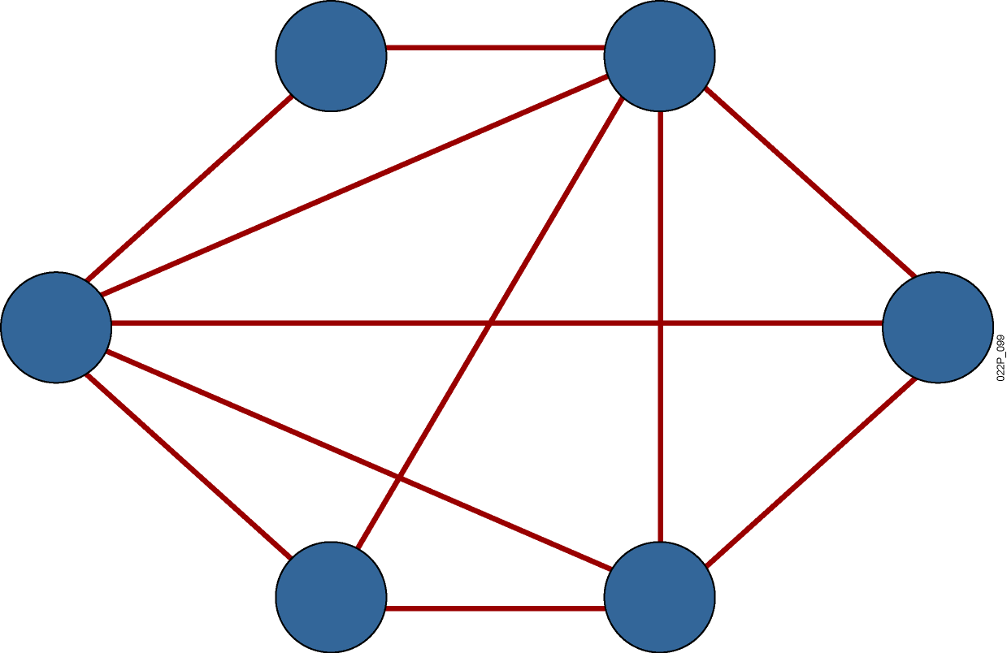
Partial-Mesh Topology
Trade-off between fault tolerance and cost

Slide 16
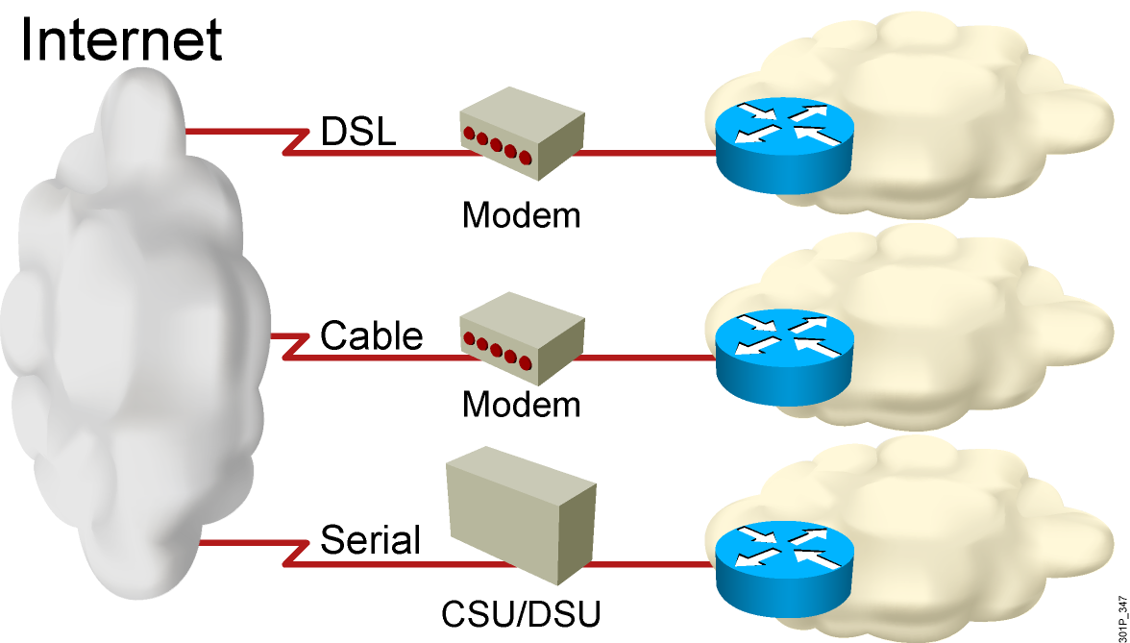
Connection to the Internet

Slide 17
OSI Model
TCP/IP

Slide 18
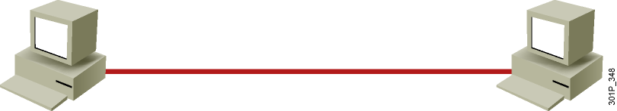
Understanding Host-to-Host Communications
Older model
Proprietary
Application and combinations software controlled by one vendor
Standards-based model
Multivendor software
Layered approach

Slide 19
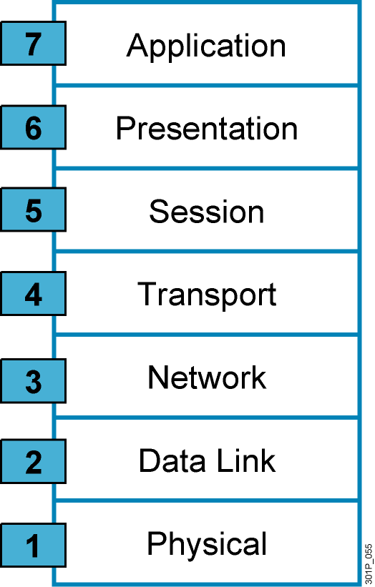
Why a Layered Network Model?
Reduces complexity
Standardizes interfaces
Facilitates modular engineering
Ensures interoperable technology
Accelerates evolution
Simplifies teaching and learning

Slide 20
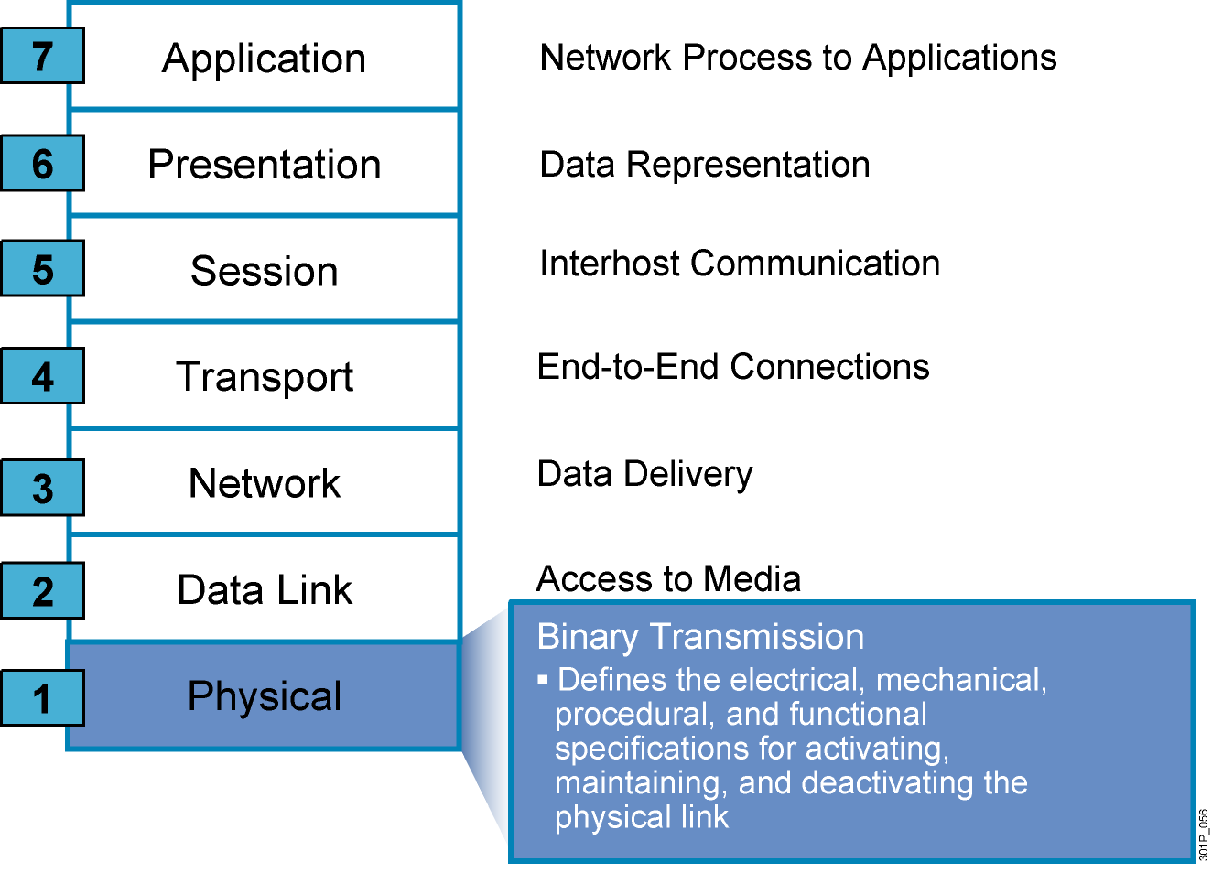
The Seven Layers of the OSI Model

Slide 21
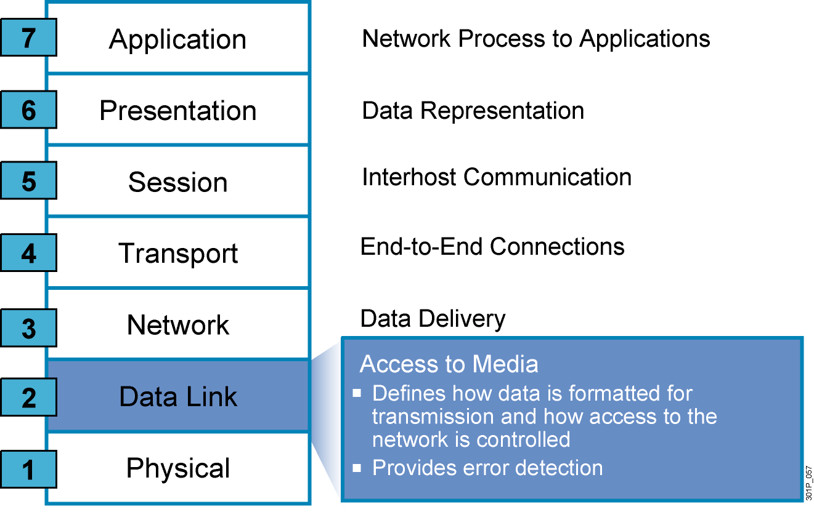
The Seven Layers of the OSI Model (Cont.)

Slide 22
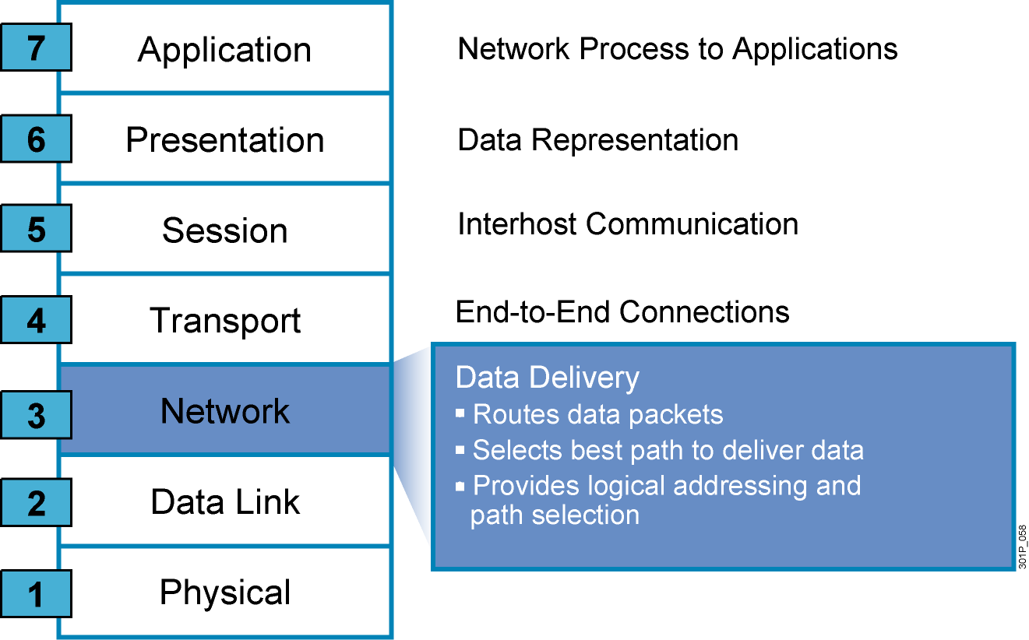
The Seven Layers of the OSI Model (Cont.)

Slide 23
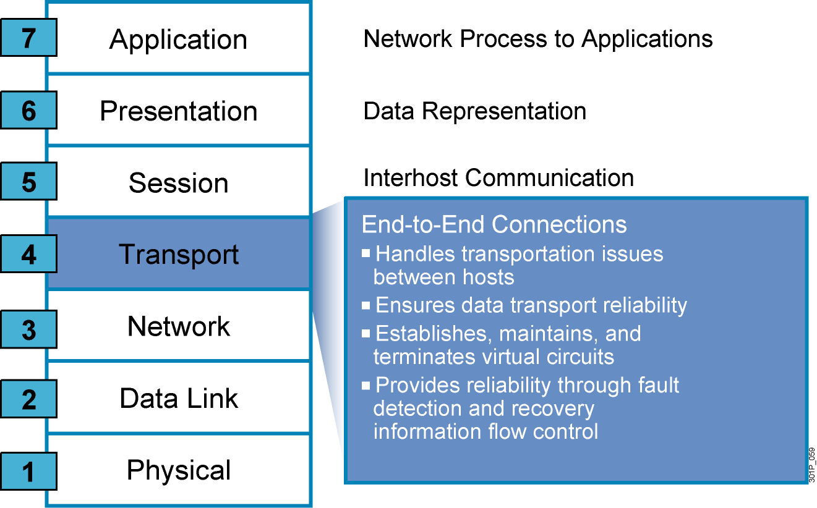
The Seven Layers of the OSI Model (Cont.)

Slide 24
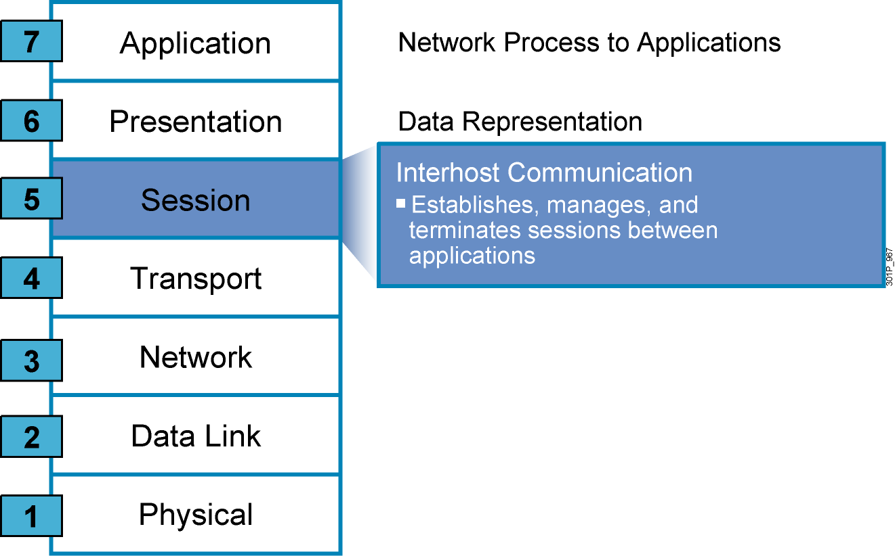
The Seven Layers of the OSI Model (Cont.)

Slide 25
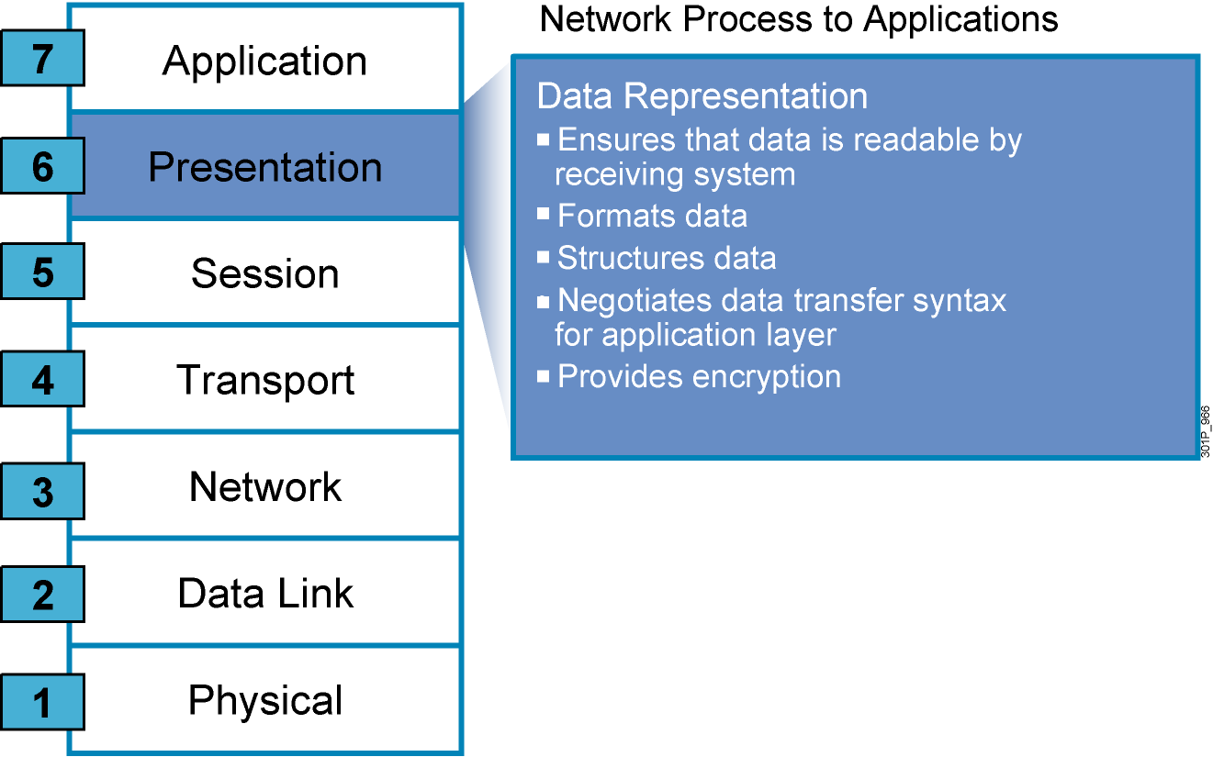
The Seven Layers of the OSI Model (Cont.)

Slide 26
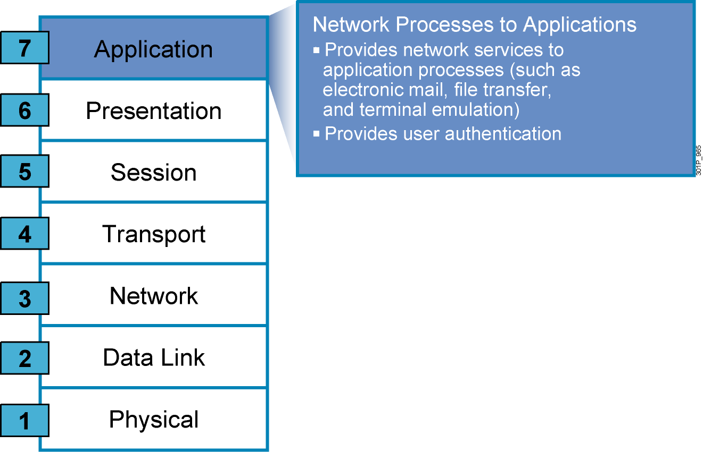
The Seven Layers of the OSI Model (Cont.)

Slide 27
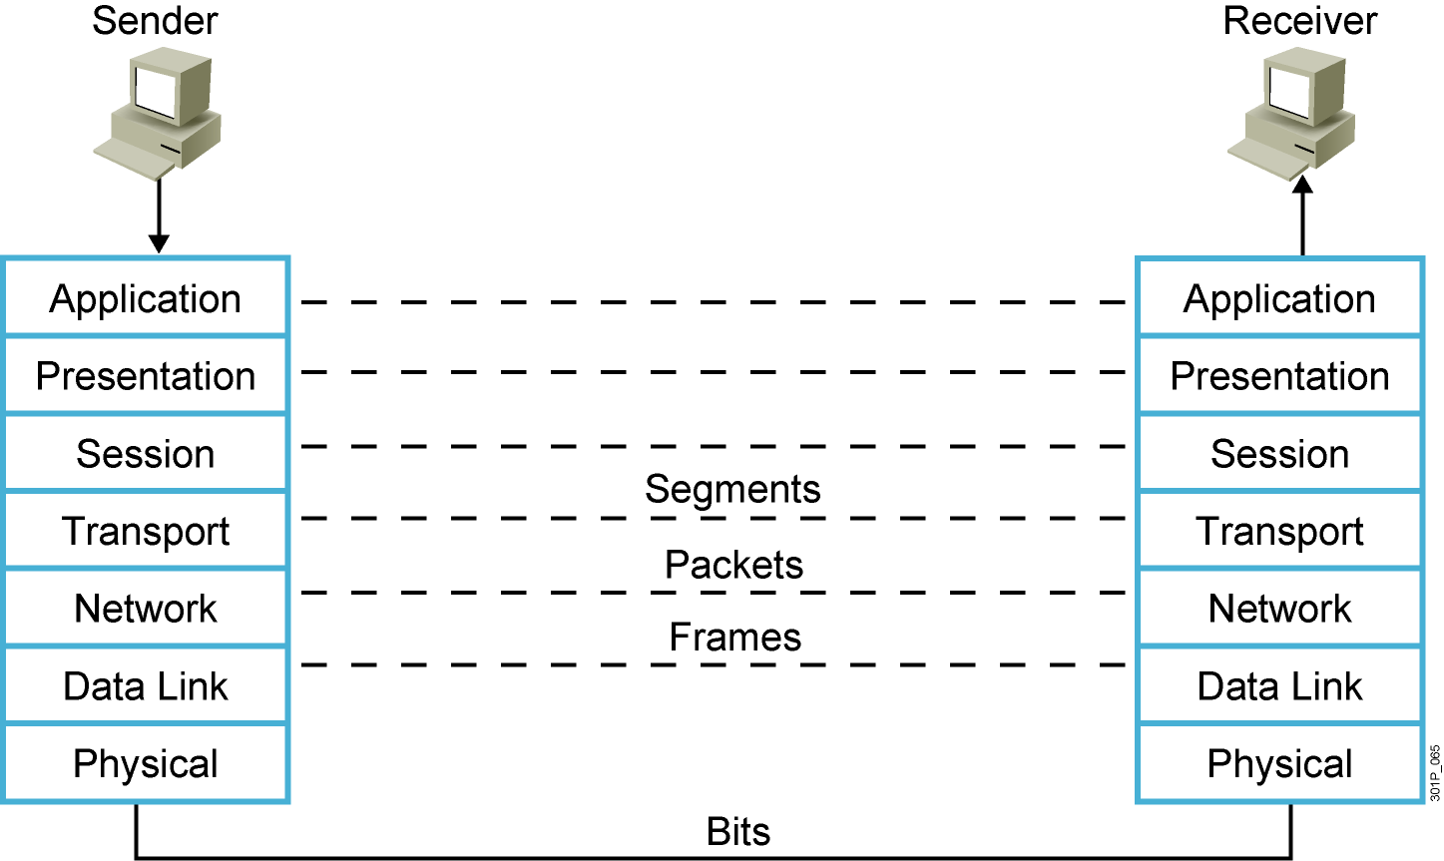
Peer-to-Peer Communication
Notes:
Lesson Aim
<Enter lesson aim here.>

Slide 28
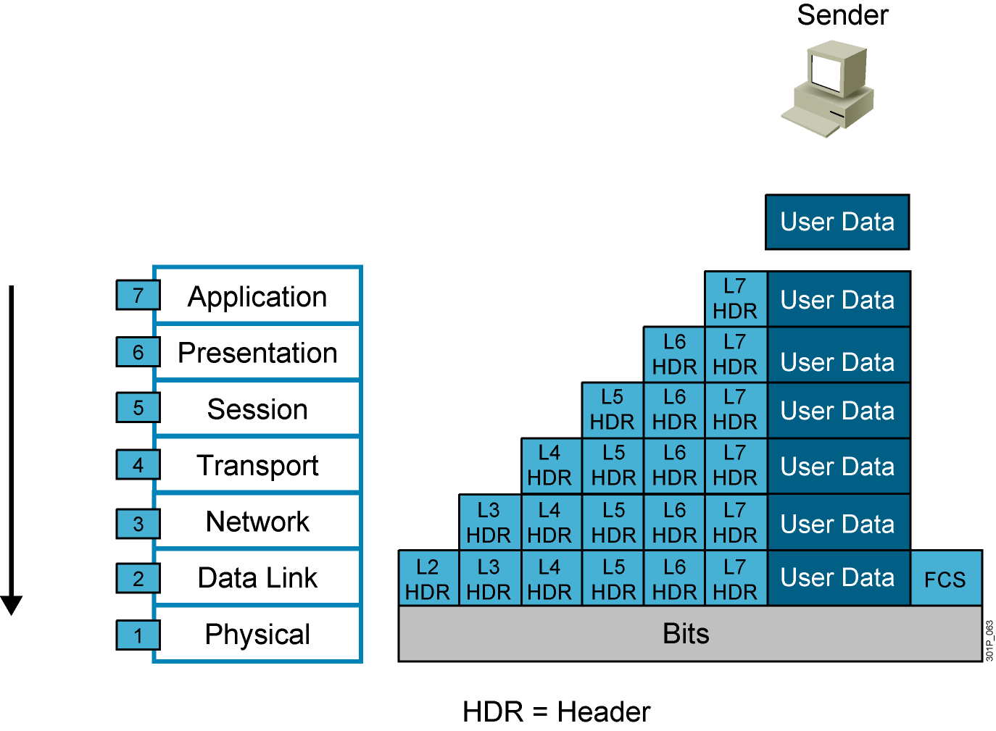
Data Encapsulation
Notes:
Lesson Aim
<Enter lesson aim here.>

Slide 29

Data De-Encapsulation
Notes:
Lesson Aim
<Enter lesson aim here.>

Slide 30
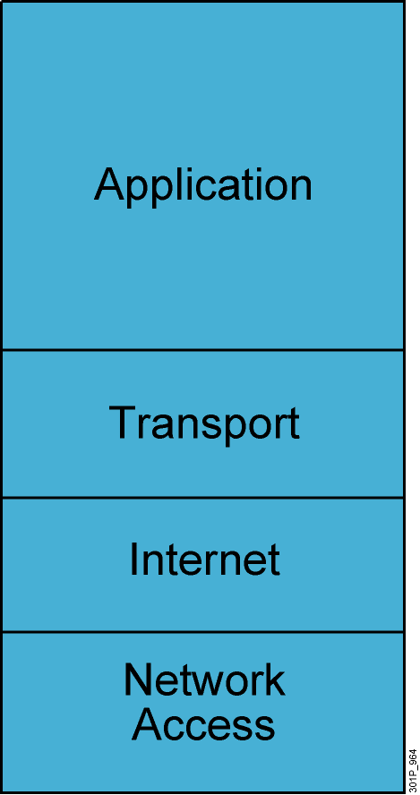
TCP/IP Stack
Defines four layers
Uses different names for Layers 1 through 3
Combines Layers 5 through 7 into single application layer
Notes:
Lesson Aim
<Enter lesson aim here.>

Slide 31
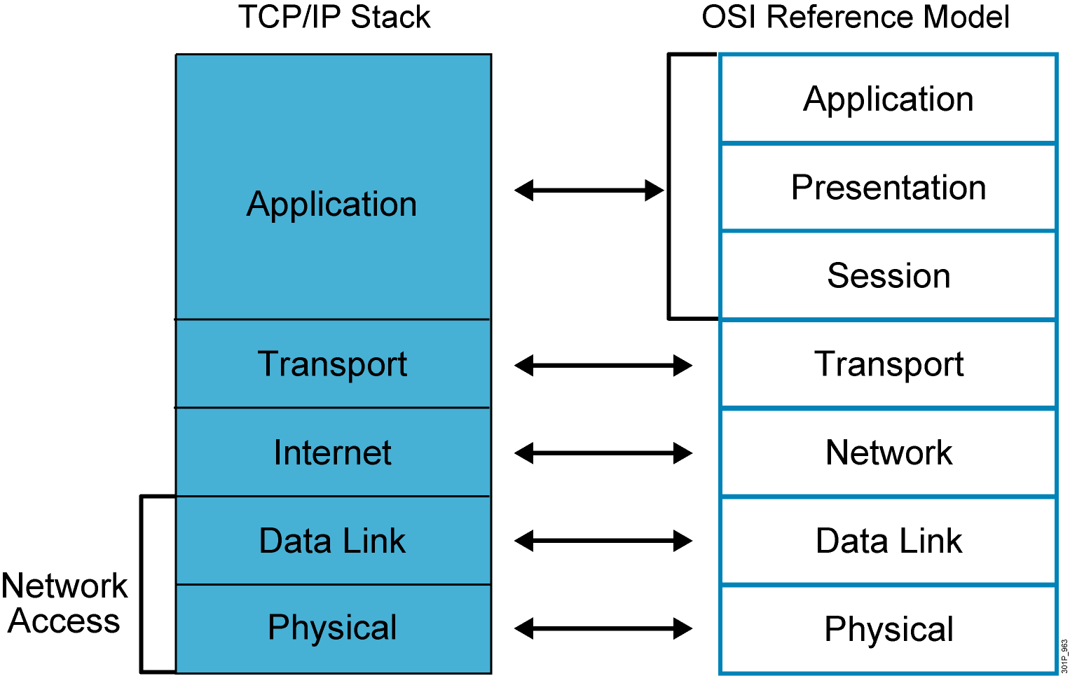
TCP/IP Stack vs. the OSI Model

Slide 32
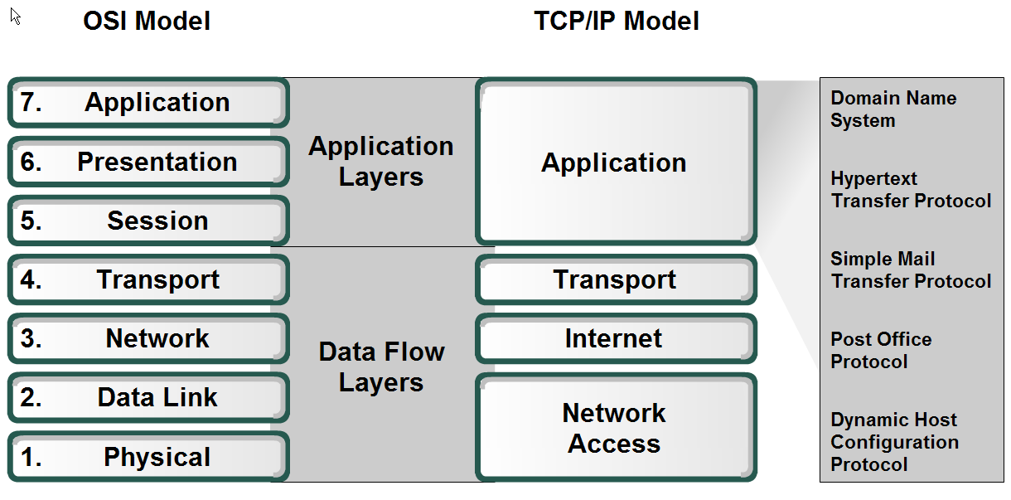
Applications

Slide 33
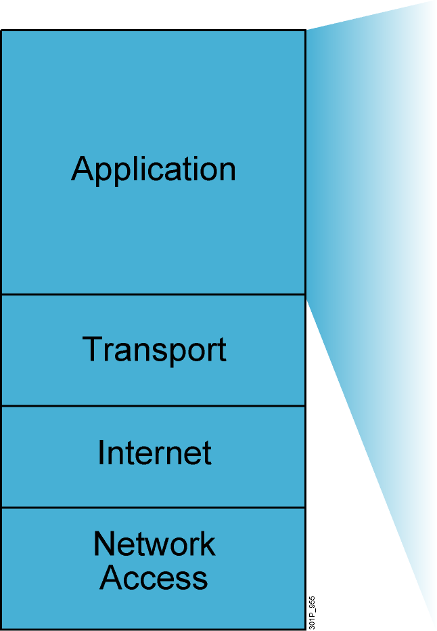
TCP/IP Application Layer Overview
File transfer
FTP
TFTP
Network File System
E-mail
Simple Mail Transfer Protocol
Remote login
Telnet
rlogin
Network management
Simple Network Management Protocol
Name management
Domain Name System
Notes:
Purpose: This figure discusses application-layer protocols.
Emphasize: The common network applications today include file transfer, remote login, network management, and e-mail.
We focus on TCP/IP in this course for several reasons:
TCP/IP is a universally available protocol and you will use it at work.
TCP/IP is a useful reference for understanding other protocols, because it includes elements that are representative of other protocols.
TCP/IP is important because the router uses it as a configuration tool. The router uses Telnet for remote configuration, TFTP to transfer configuration files and operating system images, and SNMP for network management.
Transition: The next section moves down the model to discuss the transport layer.

